Slide 1
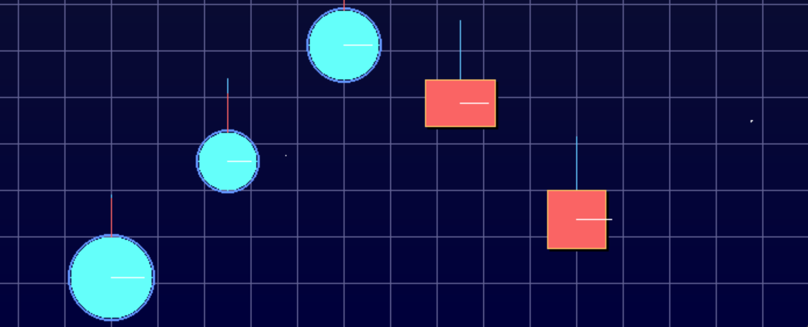
Group14：Networked Physics Sandbox
Multi-Client Network Simulation
Real-time 2D Physics • Network Synchronization • Interactive GUI

Slide 2
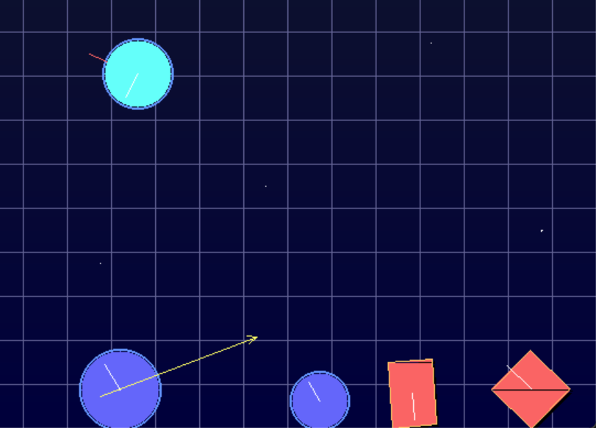
Team Members
Real-time 2D physics sandbox with multi-client sync, built in Rust from scratch.
Role | Responsibilities
🎯 Physics Engine Architect | Core physics engine, collision detection, math foundation
🌐 Network Specialist | Client-server communication, protocol design
🖥️ Server Architect | Server main loop, state management
🎨 Graphics Engineer | SDL2 rendering, visual effects
👆 Interaction Designer | Mouse interaction, UI controls
✨ Effects Engineer | Particle systems, trail effects
📦 Build Engineer | Project setup, deployment scripts
Notes:
Hello everyone, I'm Wang Yipeng. I worked on the physics engine for our project.
Our project is a 2D physics sandbox made from scratch in Rust. A key feature is that it can sync in real time across multiple users. The physics engine is the heart of the system — it handles how objects move, hit each other, and react, making everything feel real and letting all other parts work together.

Slide 3
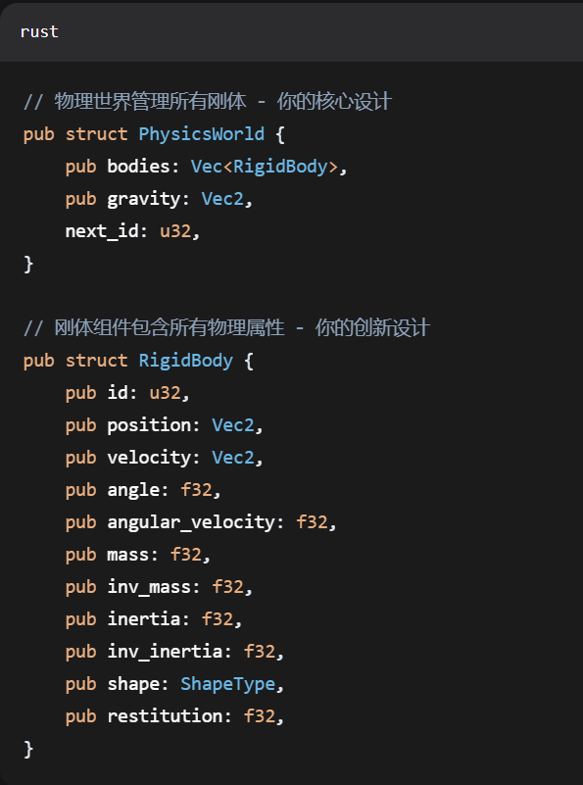
Physics Engine Architecture Design
Real-time 2D physics sandbox with multi-client sync, built in Rust from scratch.
Designed complete rigid body physics engine architecture
Implemented component-based entity system
Established mathematical foundation library
WangYiPeng
Notes:
I started with the basics. First, I built a 2D math library for vectors. It handles important actions like adding, multiplying, making a vector unit length, and finding its size. This library supports all the physics work and keeps things accurate, especially for detecting collisions.

Slide 4
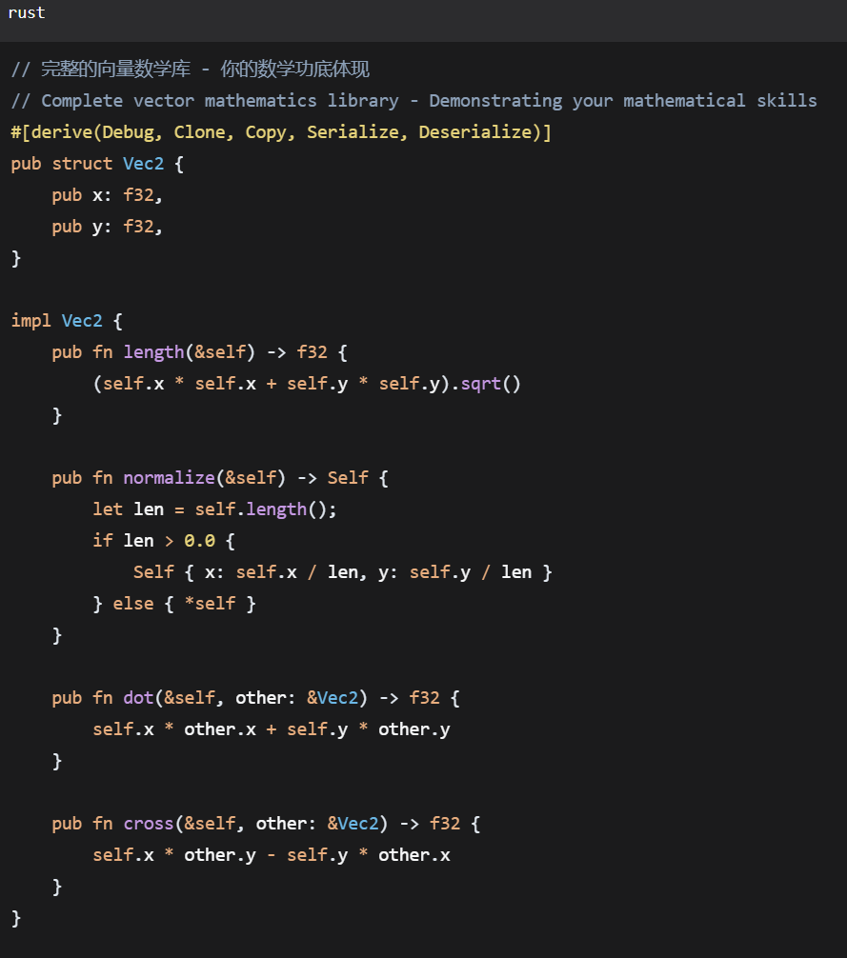
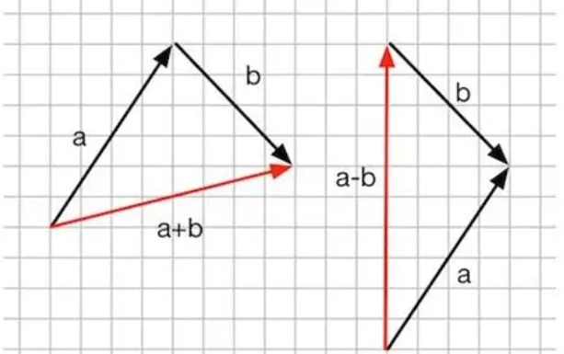
Mathematical Foundation and Vector Operations
Real-time 2D physics sandbox with multi-client sync, built in Rust from scratch.
Implemented complete 2D vector mathematics library
Supports all basic vector operations
Provides mathematical foundation for physics calculations
WangYiPeng
Notes:
Next, I set up the structure of the physics engine for solid objects using a building-block style. This means things like an object's weight, speed, position, and shape are separate parts. This makes the system more flexible and easy to grow later.

Slide 5
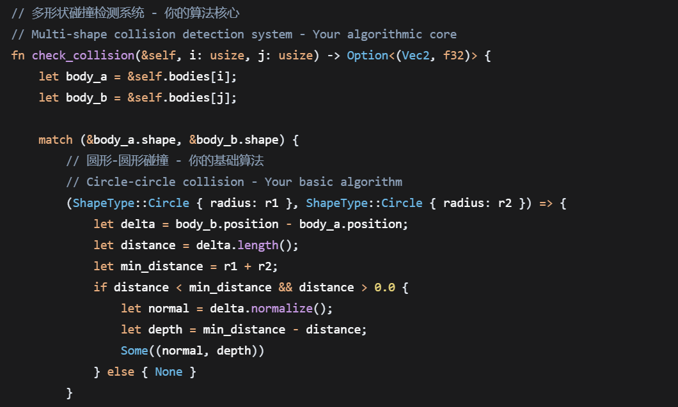
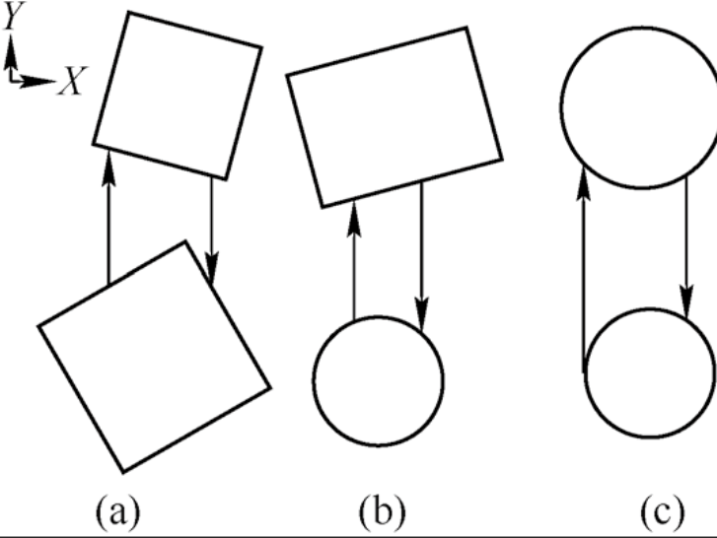
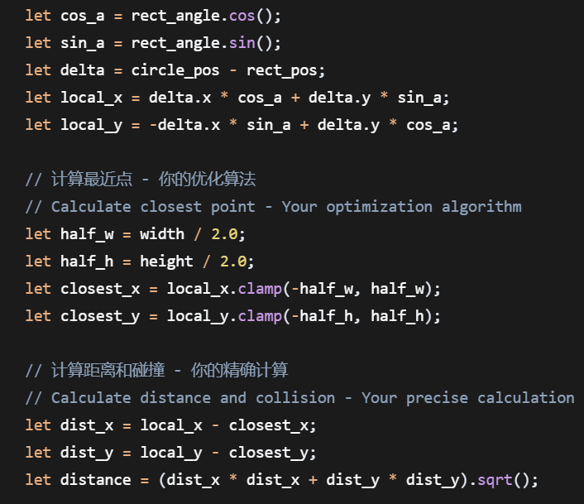
Multi-Shape Collision Detection System
Real-time 2D physics sandbox with multi-client sync, built in Rust from scratch.
Implemented circle-circle collision detection
Implemented circle-rectangle collision detection
Implemented rectangle-rectangle collision detection
Supports precise collision detection for rotated rectangles
WangYiPeng
Notes:
A big part of the physics engine is collision detection. I made three main types:
First, circle against circle — it checks if the distance between their centers is less than their combined radii.
Second, circle against rectangle. Here, we find the closest point on the rectangle to the circle and check the distance.
Third, rectangle against rectangle. This also works for rotated rectangles using a special math method (SAT) to make sure no contacts are missed.

Slide 6
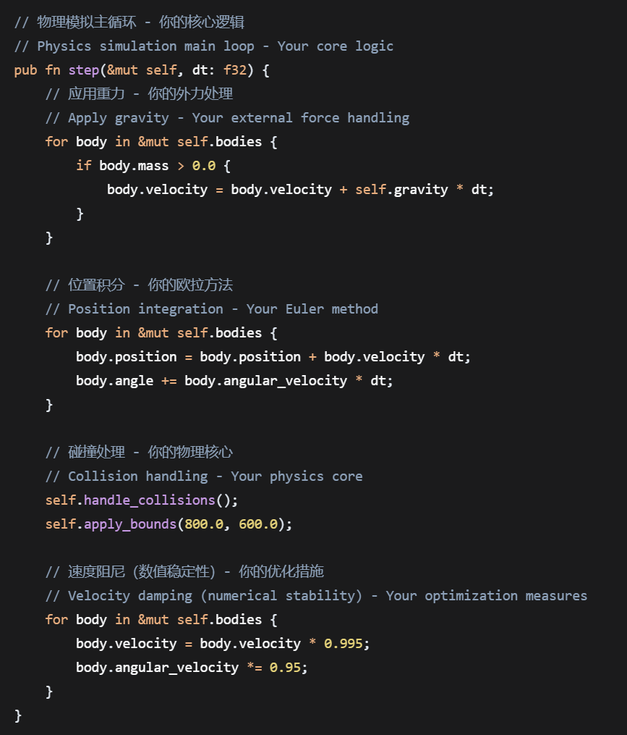
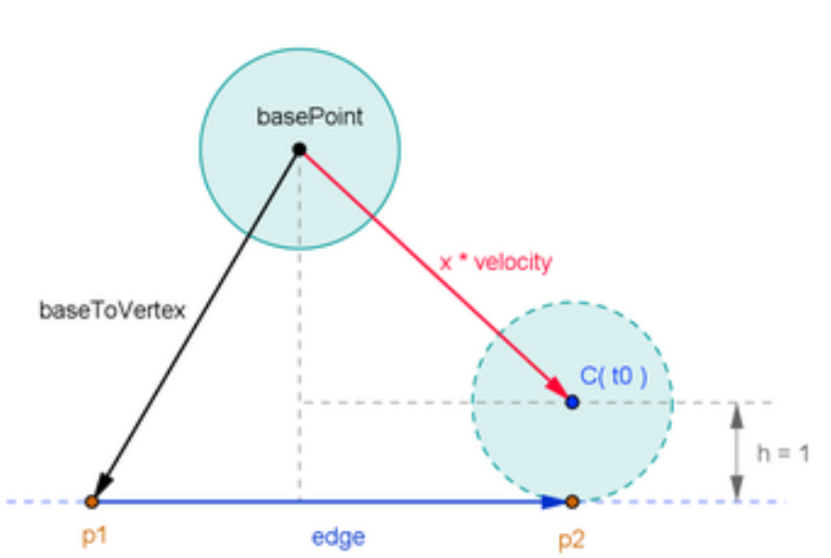
Collision Response and Impulse Calculation
Real-time 2D physics sandbox with multi-client sync, built in Rust from scratch.
Implemented impulse-based collision response
Supports linear and angular velocity
Handles penetration correction and energy conservation
WangYiPeng
Notes:
I built a 2D physics playground in Rust. It's a sandbox where things can move and crash into each other. Multiple people can connect and see the same thing happening at the same time. One of the main things I worked on was collision response. That means – what happens when two objects hit each other? I used a method called "impulse-based" response to make it work realistically. This system handles two important things: It calculates how objects move and spin after they collide – that's linear and angular velocity. It also fixes any overlapping between objects and makes sure energy is conserved, so the physics feels natural and right.

Slide 7
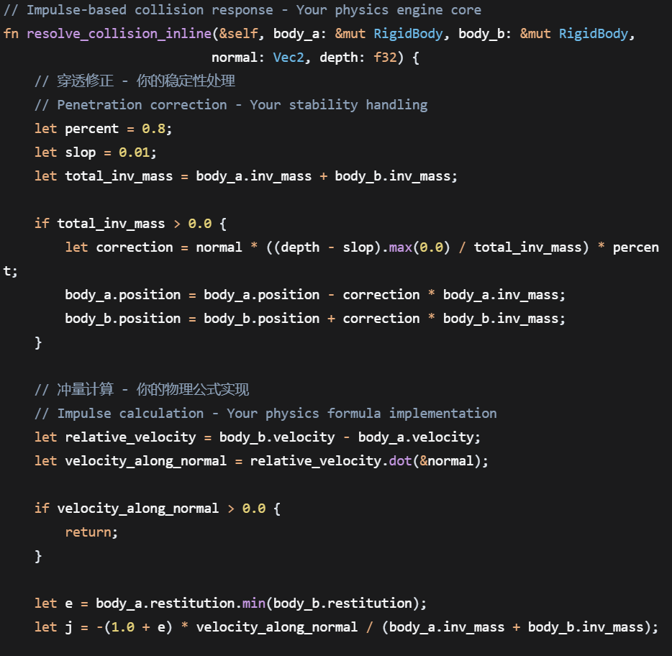
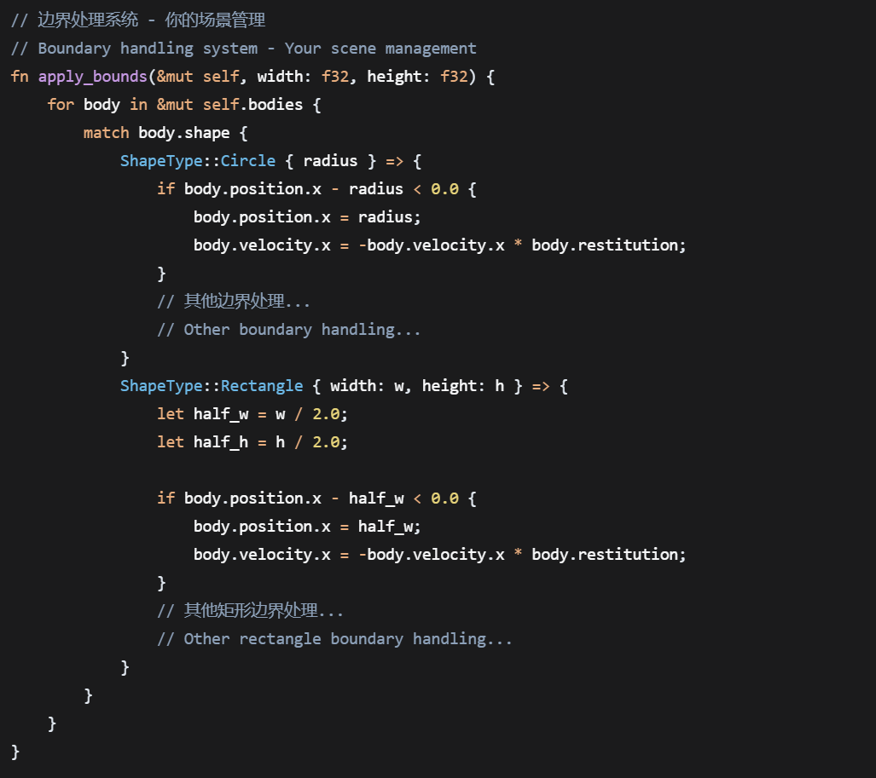
Numerical Integration and Stability
Real-time 2D physics sandbox with multi-client sync, built in Rust from scratch.
Implemented explicit Euler integration
Added numerical stability measures
Designed boundary handling system
WangYiPeng
Notes:
Finally, to keep everything running well, I used a step-by-step method to update object positions each frame. I also added steps for number stability, like setting a top speed, and made a border system to stop objects from leaving the screen.So, from the basic math to the main engine parts and improvements, we built a full physics system. It gives a strong base for network sync and multi-user action. Next, I'll hand it over to Gao Yile, who worked on the network part. He'll tell you how we made this physics world update in real time across many users.

Slide 8
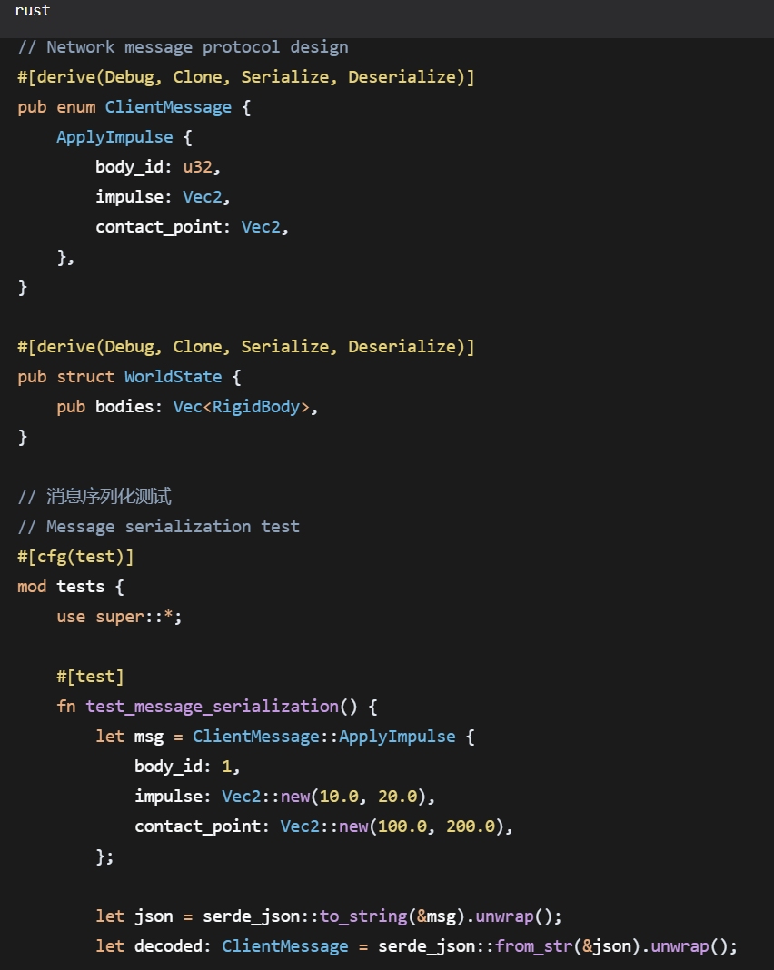
Network Protocol Design
Person 2: Network Communication Expert
serialization format design
JSON protocol definition
Real-time synchronization mechanism
GaoYiLe
Notes:
Hello everyone, I'm Gao Yile, responsible for the project's network communication module. Thanks to Wang Yipeng for laying such a solid physics foundation—if the physics engine is the "backbone," the network module is like the "nervous system" connecting multiple clients, with the core goal of enabling all clients to share the same physical world in real time.

Slide 9
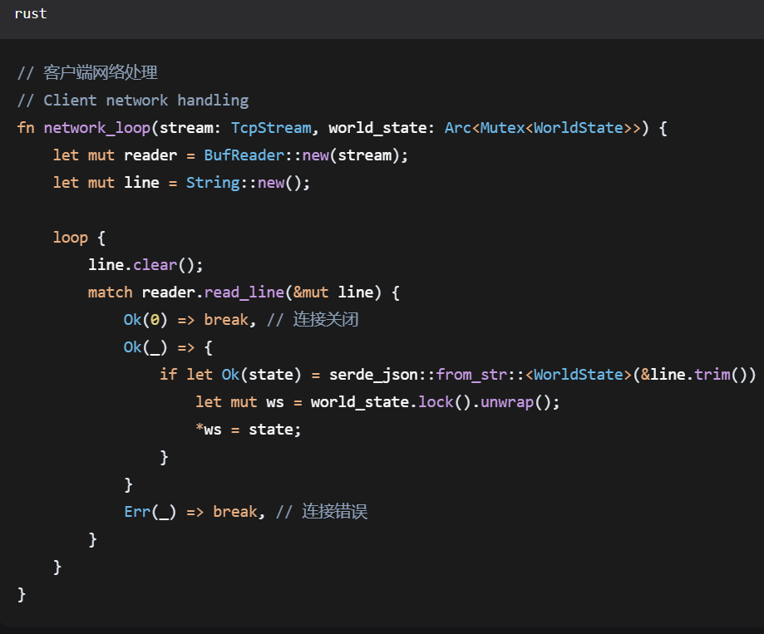
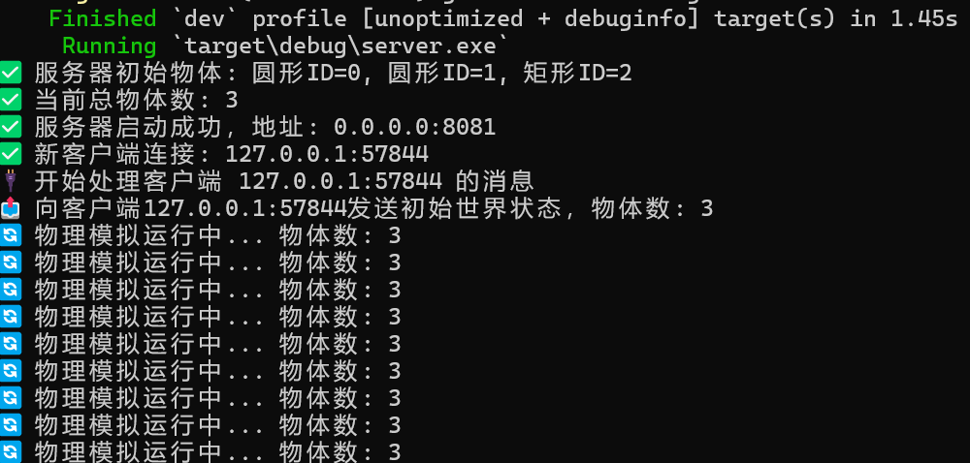
Client-Server Communication
Person 2: Network Communication Expert
TCP connection management
Message routing design
Connection state handling
GaoYiLe
Notes:
We designed a JSON-based network protocol and used the Serde library for fast data serialization and deserialization to ensure error-free transmission. We manage connections via the TCP protocol, which stably handles scenarios such as connection establishment, data transmission, and reconnection after disconnection.

Slide 10
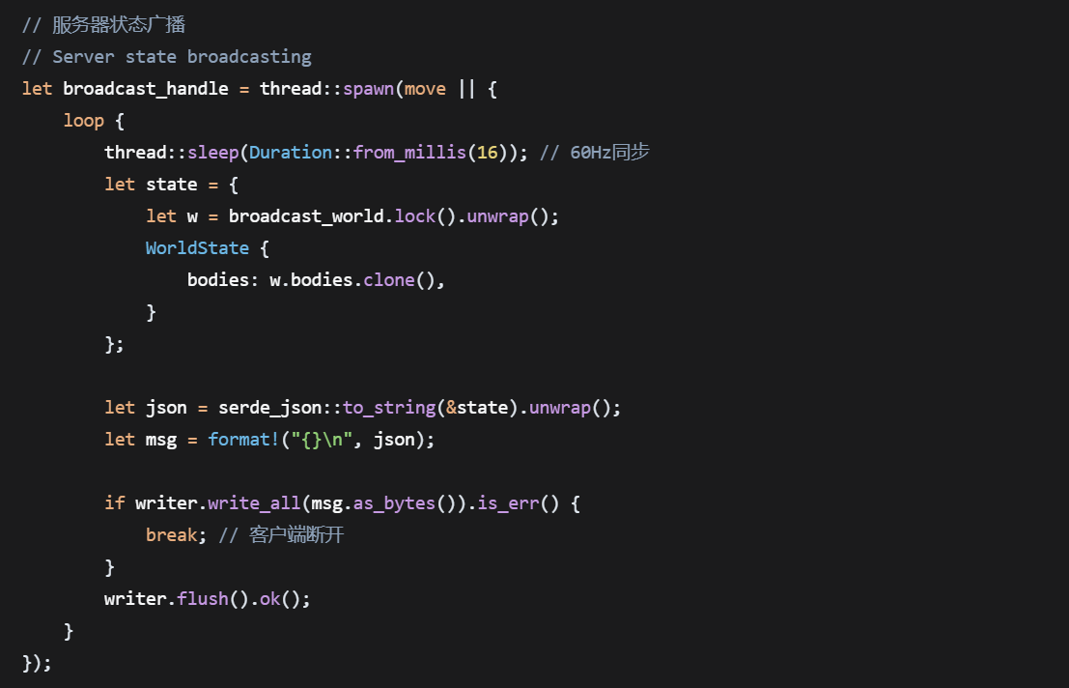
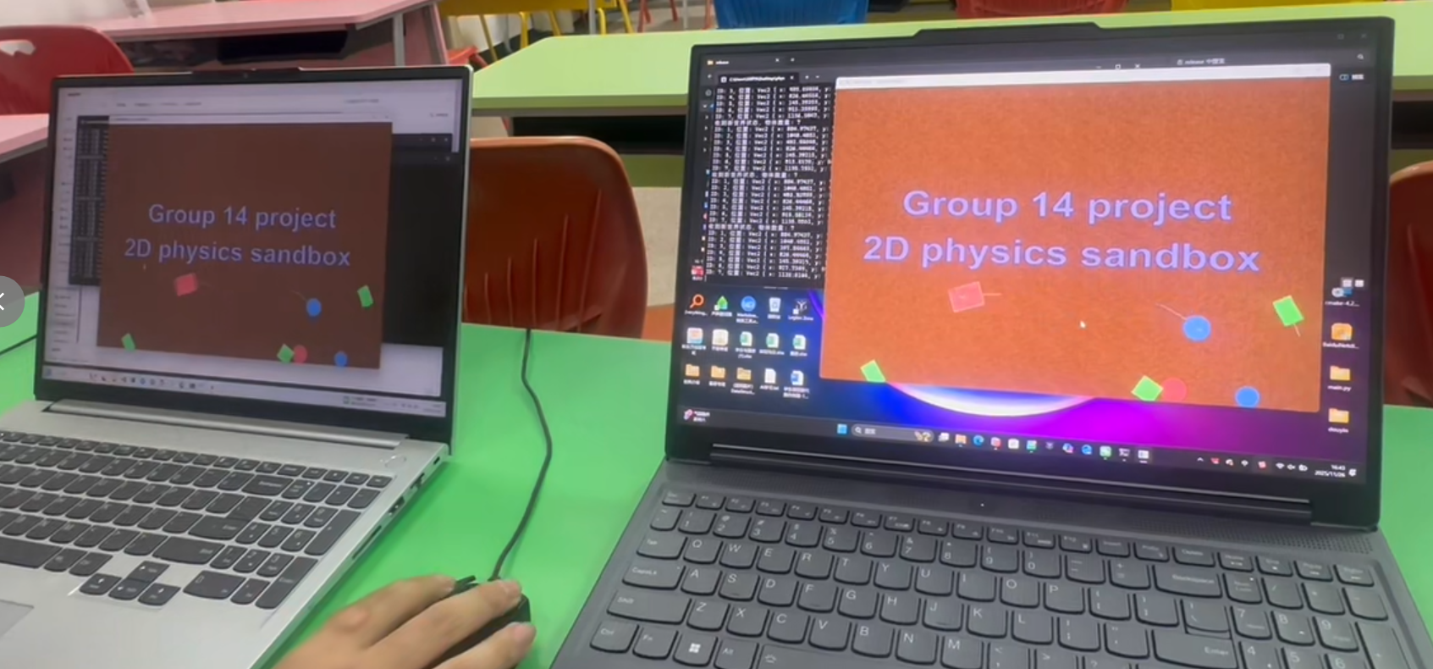
State Synchronization Strategy
Person 2: Network Communication Expert
World state broadcasting
Client prediction
Conflict resolution
GaoYiLe
Notes:
To address real-time synchronization issues, we adopted a three-pronged strategy: server-side global state broadcasting, client-side local prediction, and server-prioritized conflict resolution, which minimizes lag caused by network latency. We also implemented multiple performance optimizations, including message compression, bandwidth optimization, and network fluctuation mitigation. Specialized network tests have verified the stability of connections and the accuracy of data transmission.

Slide 11
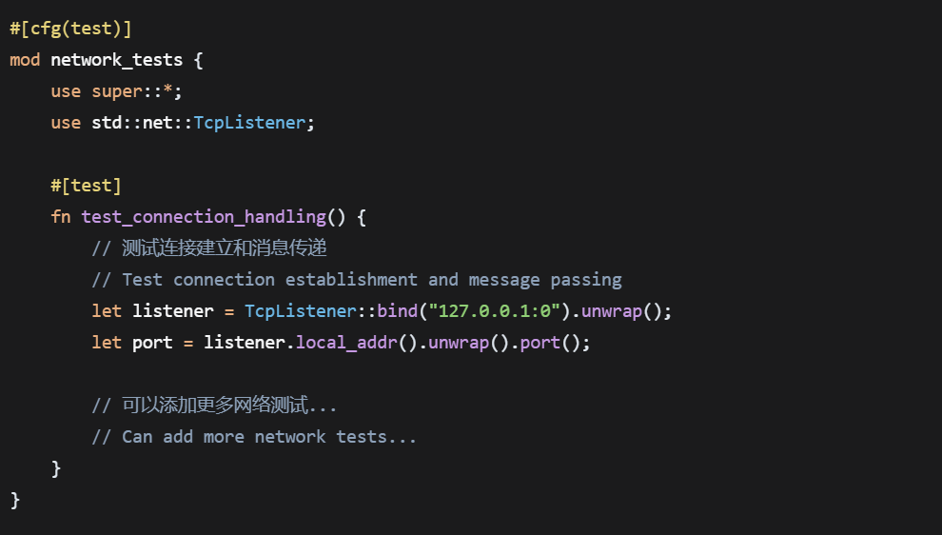
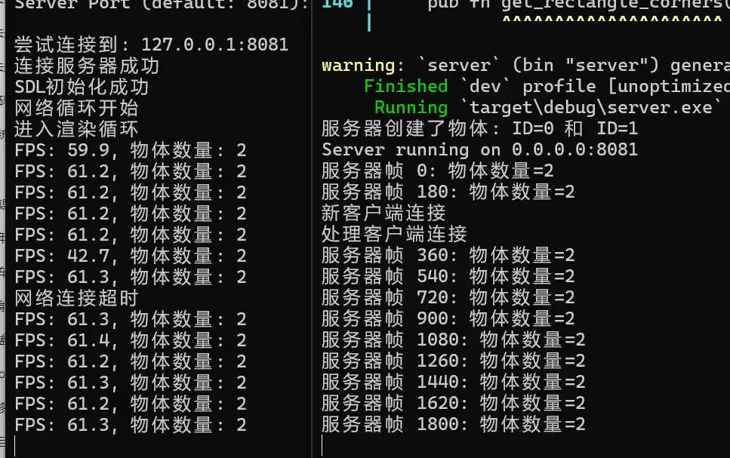
Network Performance Optimization
Person 2: Network Communication Expert
Message compression
Bandwidth optimization
Latency handling
GaoYiLe
Notes:
Next, let's welcome Zhang Boyang to explain how the server processes these network requests and physics calculations.

Slide 12
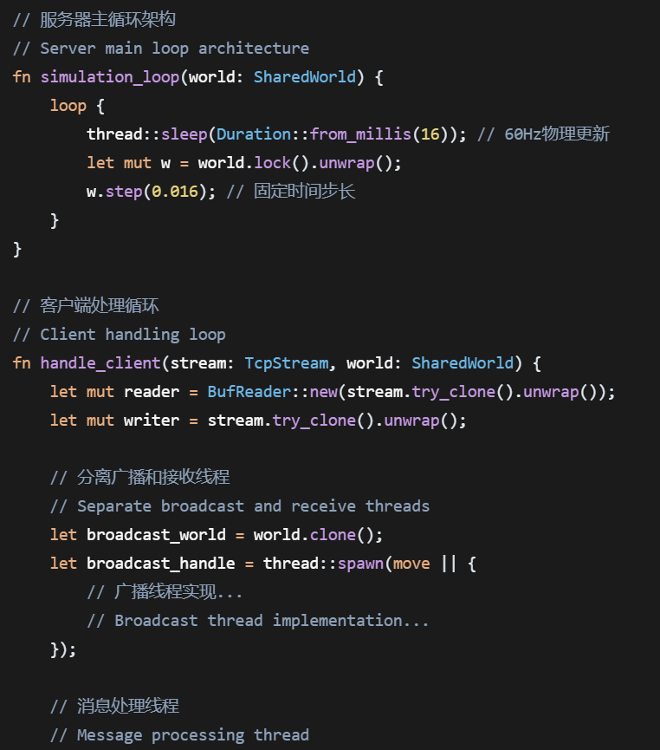
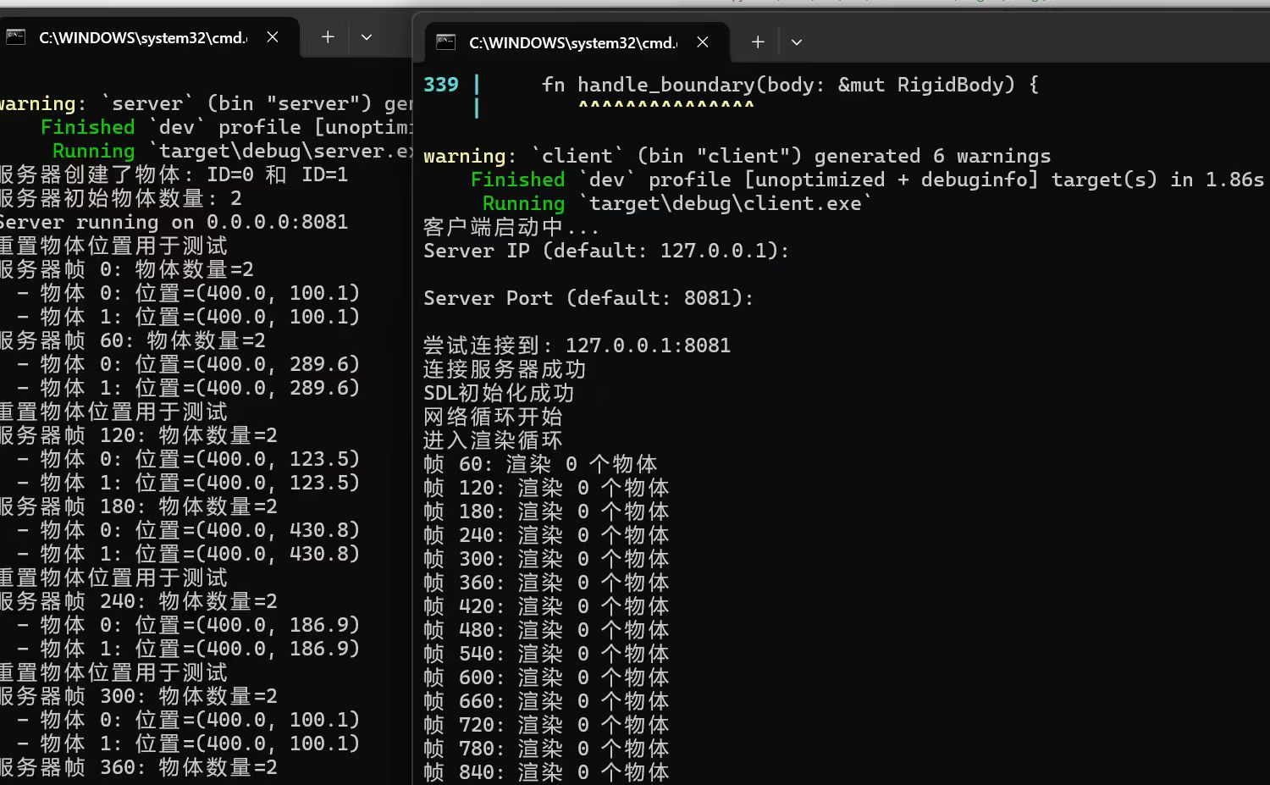
Server Main Loop
Person 3: Server Architect
Game loop design
Time step management
Thread safety
ZhangBoYang
Notes:
Thank you, Gao Yile, for the reliable network support! Hello everyone, I’m Zhang Boyang, responsible for designing and implementing the server architecture. As the "central brain" of the project, the server needs to handle three core tasks at the same time: physics simulation, client management, and state synchronization.

Slide 13
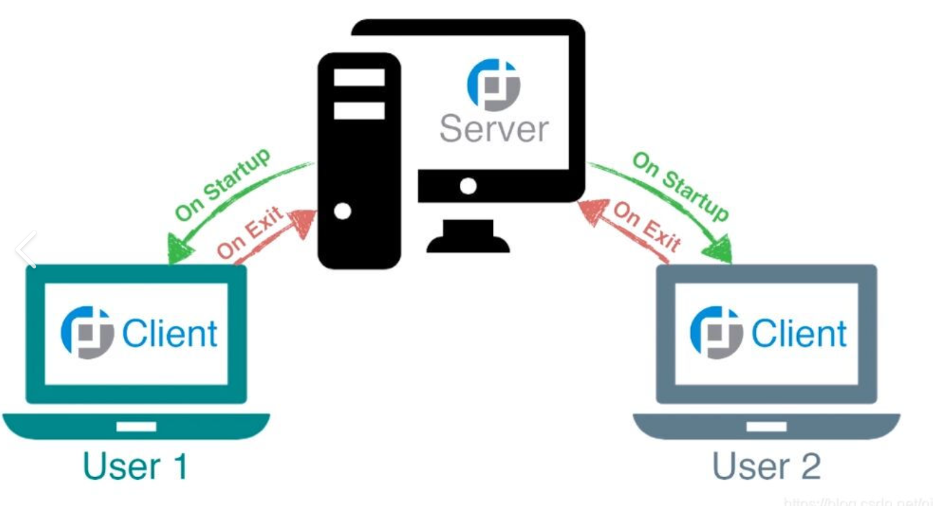
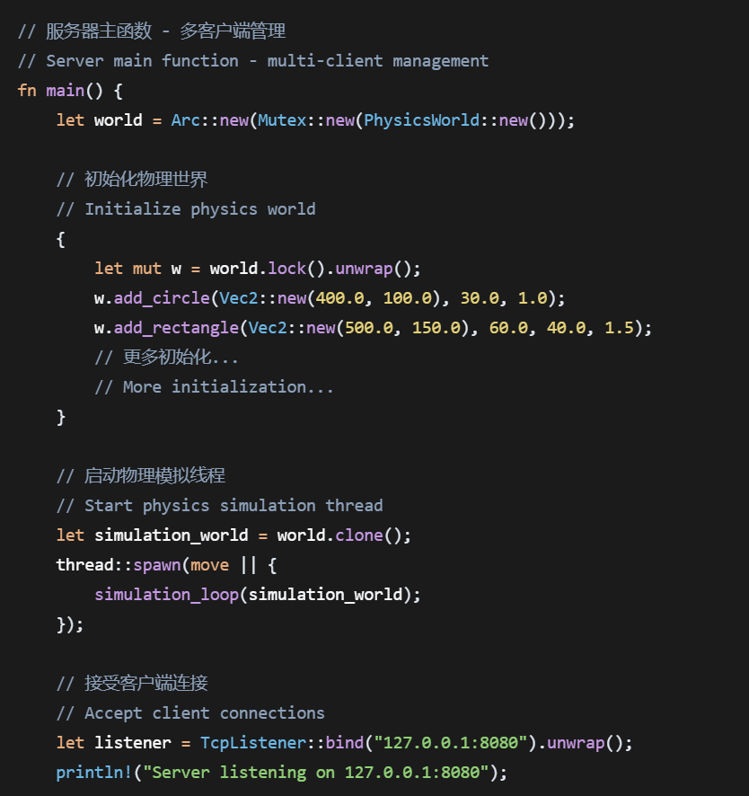
Multi-Client Management
Person 3: Server Architect
Client session management
Message distribution
Resource cleanup
ZhangBoYang
Notes:
My main work was designing the server’s main loop. We use a fixed time step of 60Hz to update the physics world—this means running a simulation every 16 milliseconds, which matches the visual frame rate of clients. To ensure thread safety, we use shared locks to manage the world state. We also separated the broadcast thread and message processing thread to avoid stuttering caused by task blocking.

Slide 14
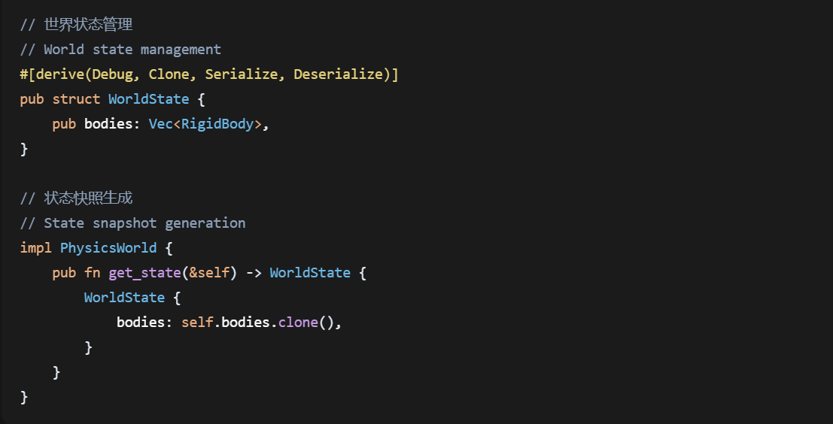
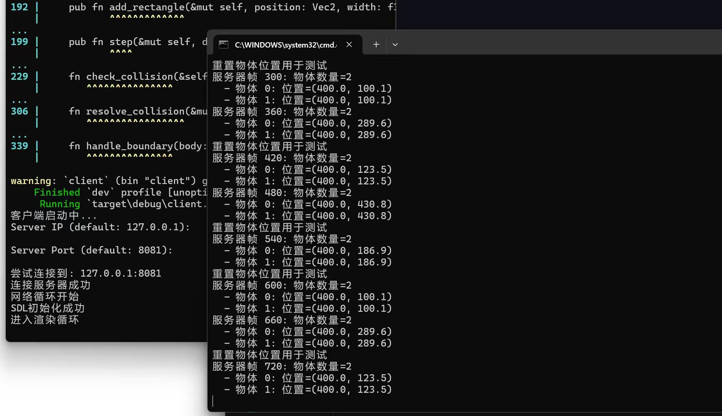
State Management
Person 3: Server Architect
Rigid body state maintenance
State cloning and serialization
State broadcasting
ZhangBoYang
Notes:
For multi-client management, we implemented a complete session management system. It includes connection setup, message distribution, and resource cleanup. This ensures every client’s request gets a timely response, and resources are quickly released when a client disconnects. For state management, we maintain the real-time state of all rigid bodies. We implement state cloning, serialization, and broadcasting to make sure the server’s world state is accurately synced to every client.

Slide 15
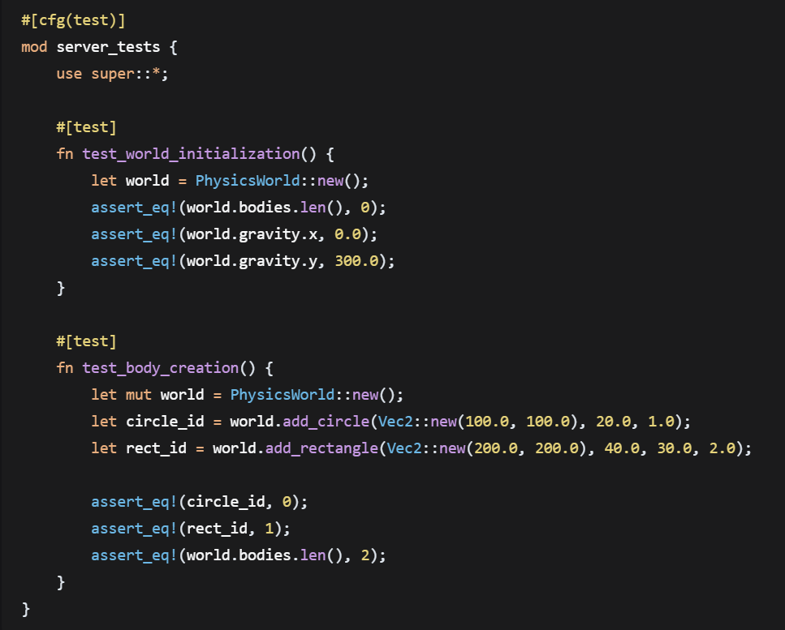
Server Optimization and Testing
Person 3: Server Architect
Memory usage optimization
Thread pool consideration
Load balancing
ZhangBoYang
Notes:
In addition, we optimized memory usage efficiency. We’re considering adding a thread pool to improve concurrency and designed a load balancing strategy to handle pressure from multiple clients. Tests show the server can stably support concurrent requests from multiple clients, providing reliable support for the whole system. Next, let’s hand over to Zheng Zhekai to show how backend data is turned into intuitive visual effects.

Slide 16
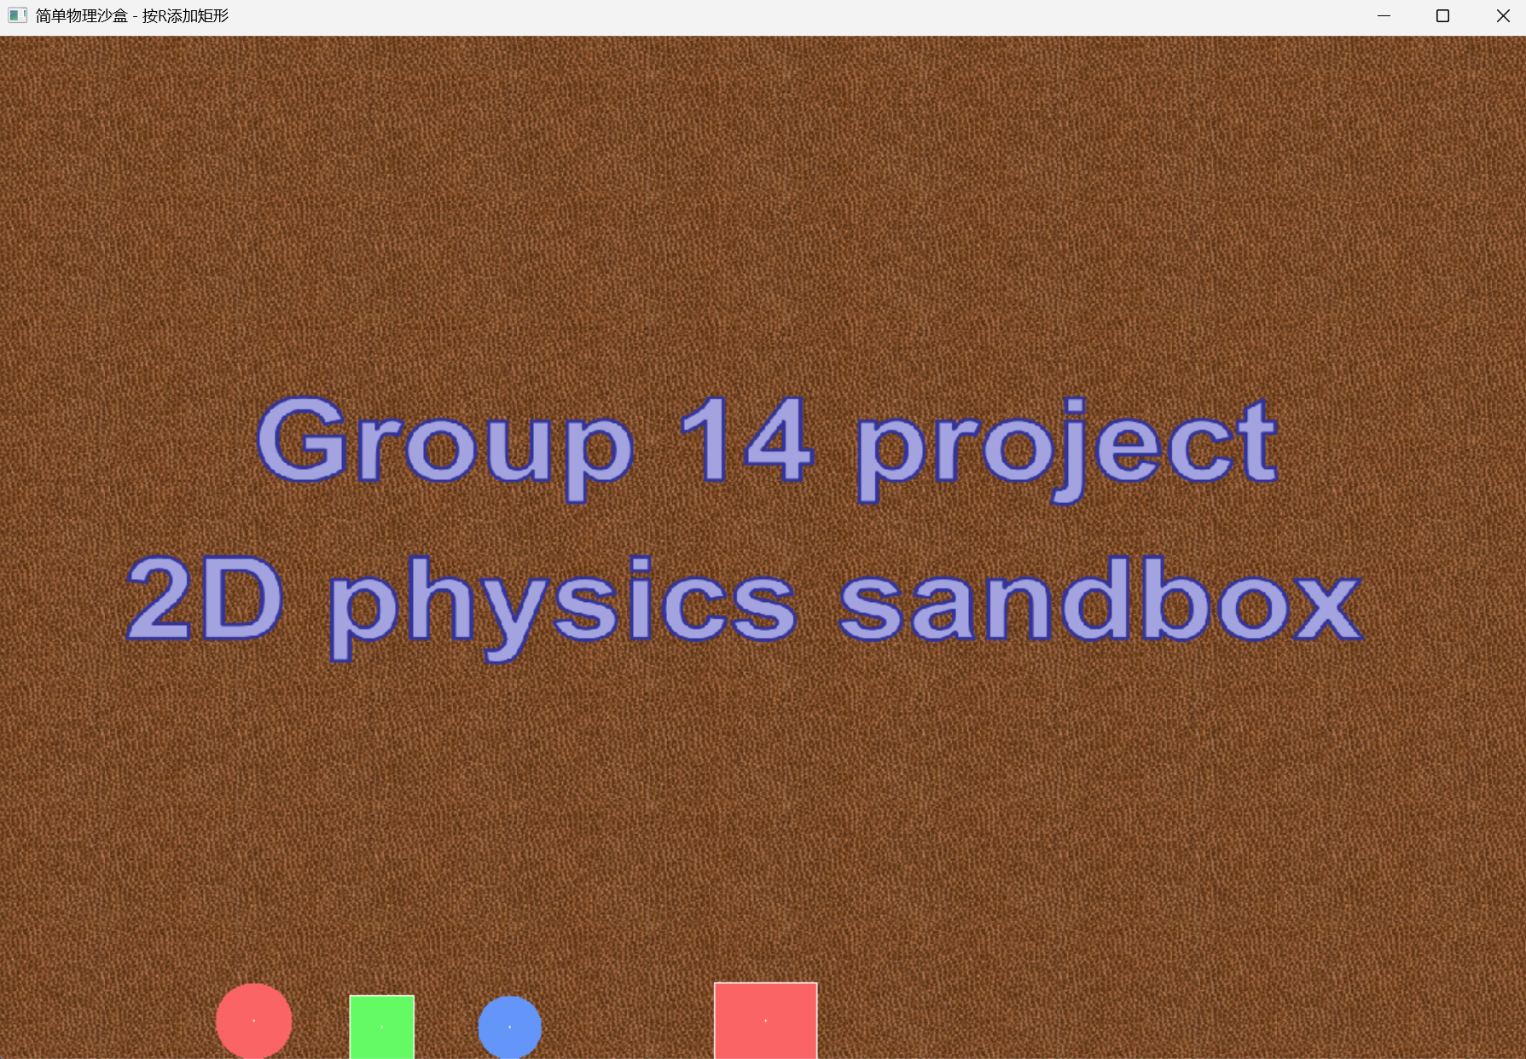
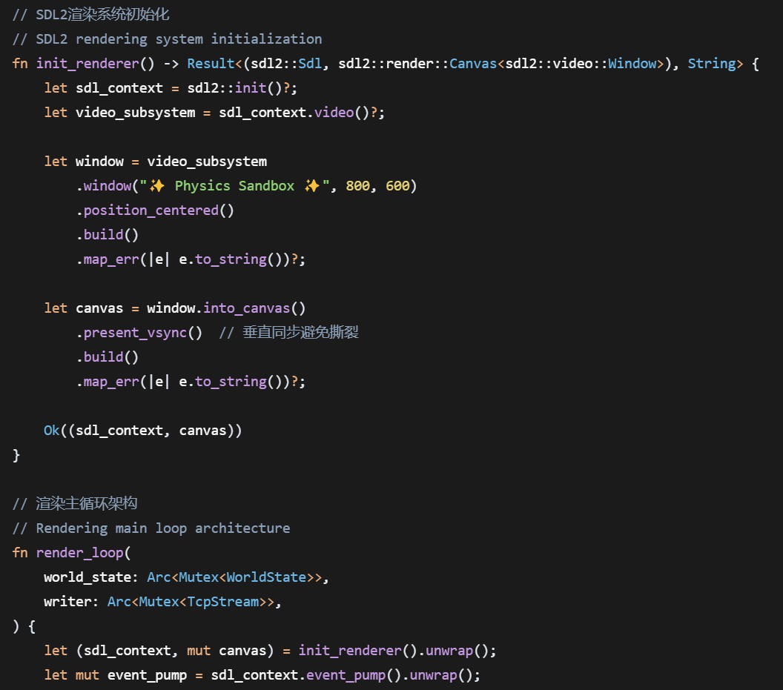
SDL2 Rendering Architecture
Person 4: Graphics Rendering Engineer
Canvas creation and configuration
Color and drawing settings
Double buffering and vertical sync
ZhengZheKai
Notes:
Thanks to Zhang Boyang for the stable server support! Hello everyone, I’m Zheng Zhekai, in charge of the graphics rendering module. My goal is to turn the backend data from the physics engine and server into smooth, beautiful visual effects, letting users directly feel the charm of the physics world.

Slide 17
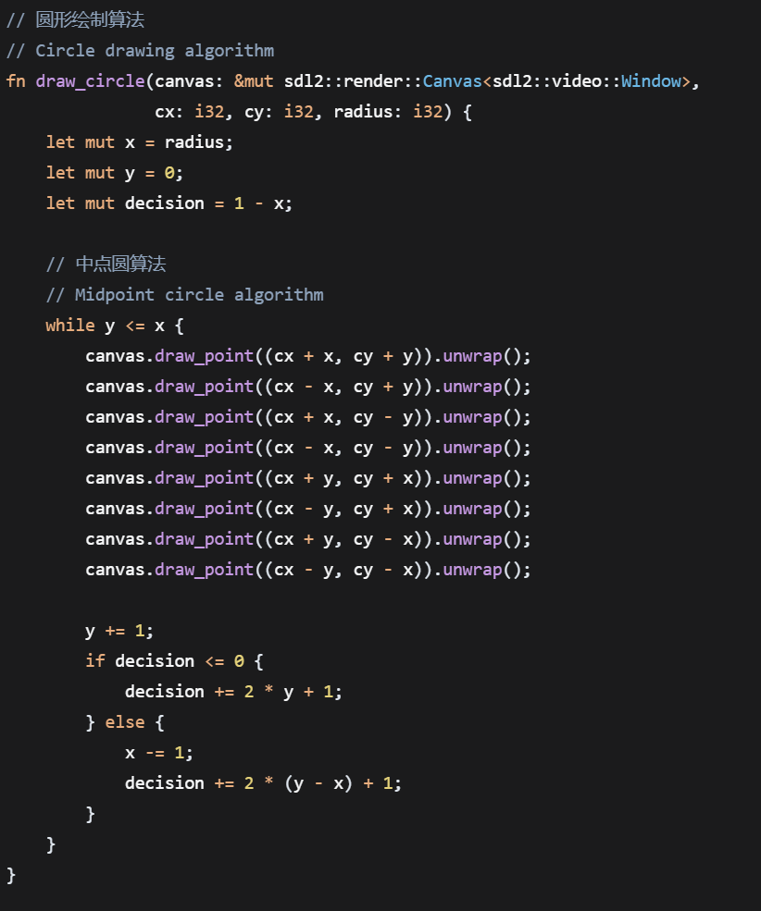
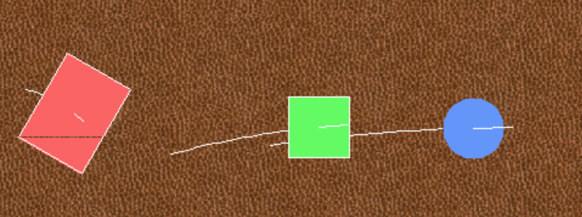
Shape Rendering Algorithms
Person 4: Graphics Rendering Engineer
Circle drawing algorithm
Rectangle drawing (considering rotation)
Polygon filling
ZhengZheKai
Notes:
I built a complete rendering architecture based on SDL2. This includes canvas creation, color configuration, double buffering, and vertical sync settings. These features prevent screen tearing from the bottom up and ensure smooth rendering. For shape rendering:

Slide 18
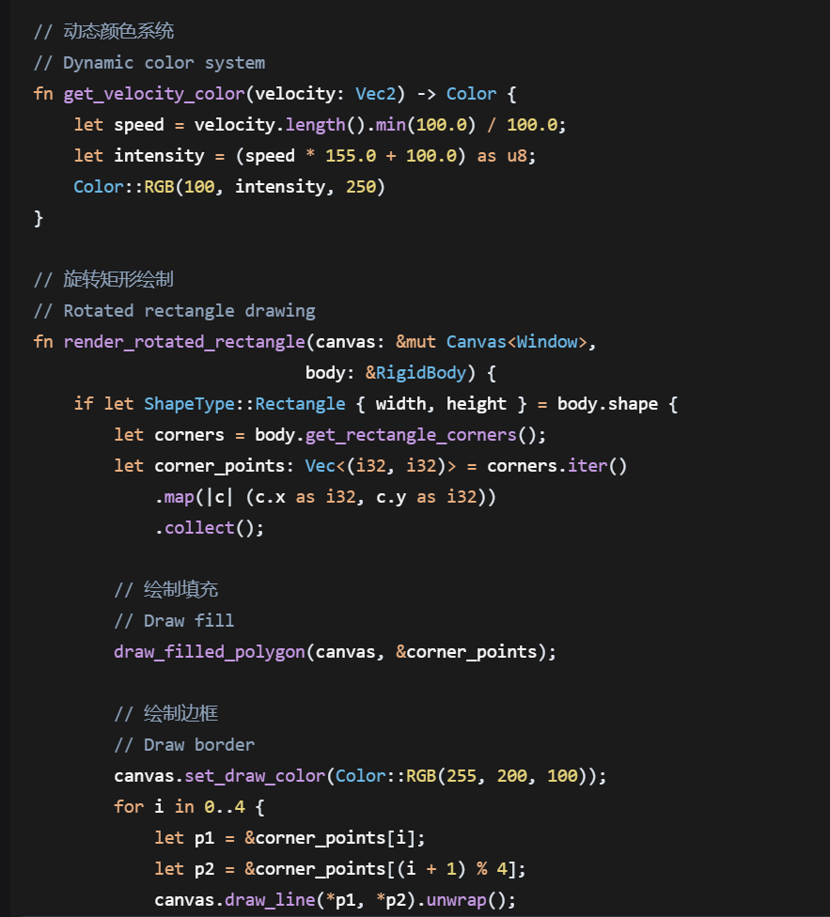
Advanced Visual Effects
Person 4: Graphics Rendering Engineer
Trail line drawing
Particle drawing (with transparency)
Color gradients
ZhengZheKai
Notes:
Circles use the midpoint circle algorithm, which draws smooth shapes efficiently.
Rectangles support both normal and rotated scenarios; we calculate vertices to achieve accurate rendering.
We also support polygon filling, which provides a foundation for complex shapes.

Slide 19
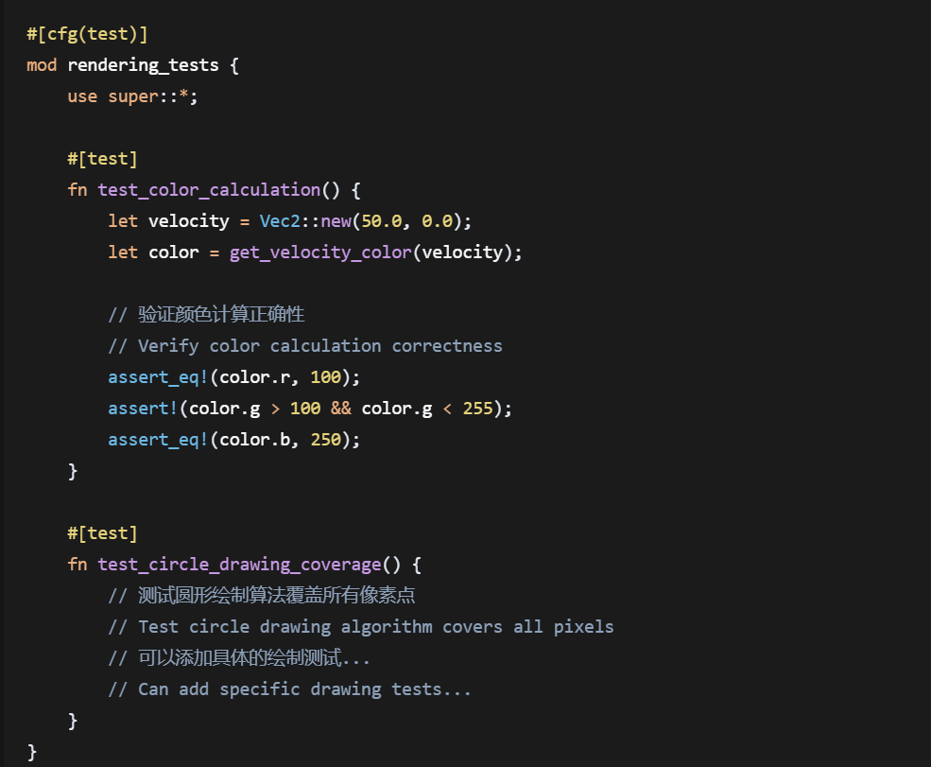
Rendering Optimization and Testing
Person 4: Graphics Rendering Engineer
Performance mode switching
Simplified rendering path
Particle count control
ZhengZheKai
Notes:
We added advanced visual effects too: trajectory drawing for moving objects, particle effects with transparency, and a dynamic color system. The color system automatically adjusts color intensity based on object speed, making the visuals more layered. For performance optimization, we designed performance mode switching. It can simplify the rendering path and control the number of particles, ensuring smooth operation even on low-end devices. Next, let’s pass to He Peng to explain how users can interact smoothly with these visual elements.

Slide 20
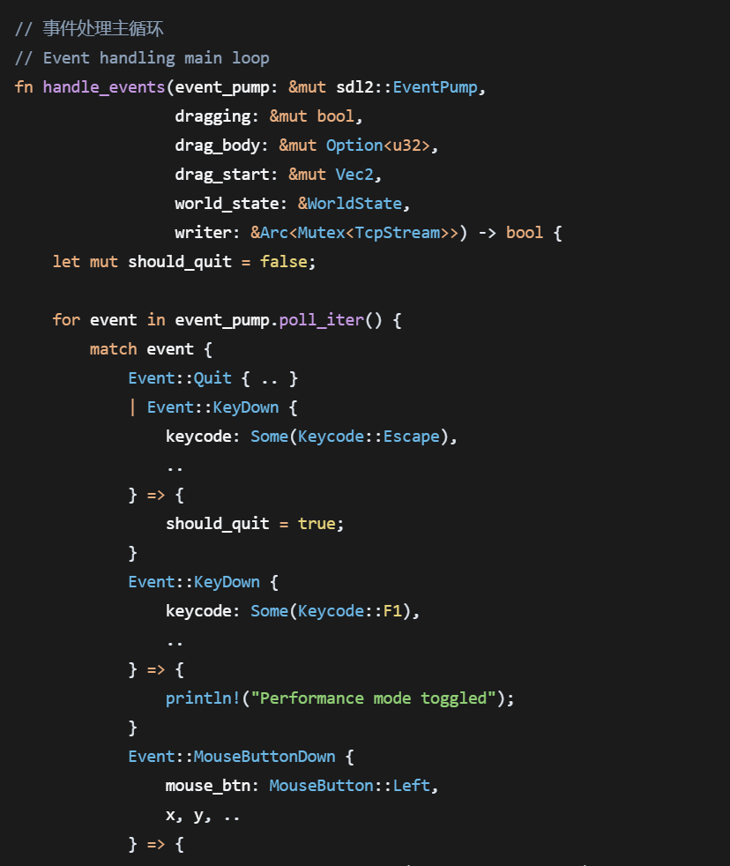
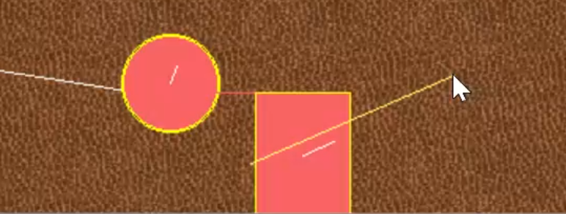
Event Handling System
Person 5: User Interaction Designer
SDL2 event loop
Keyboard events
Mouse events
HePeng
Notes:
Thanks to Zheng Zhekai for the great visual presentation! Hello everyone, I’m He Peng, responsible for the user interaction module. Interaction is like the "bridge" between users and the project. Its core is to make operations intuitive and smooth, letting users easily control the physics world.I built an event handling system based on SDL2 that supports capturing and processing keyboard and mouse events.

Slide 21
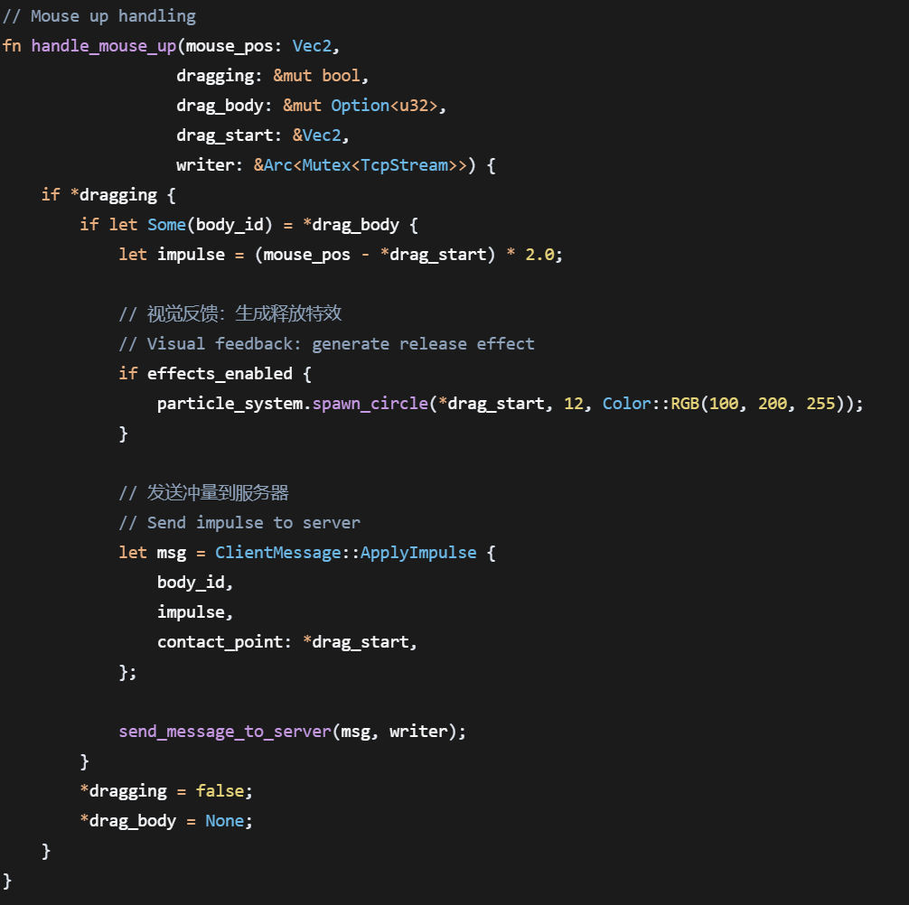
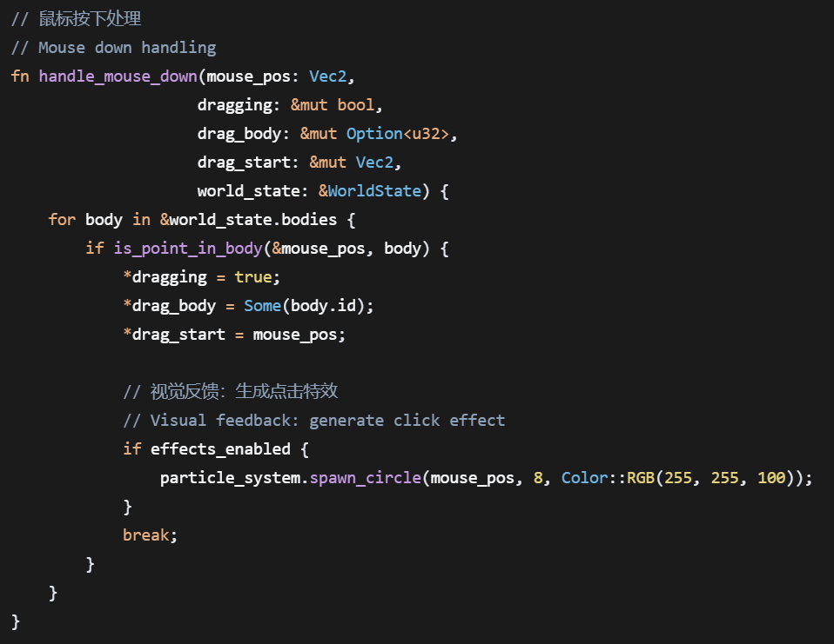
Drag Interaction Design
Person 5: User Interaction Designer
Mouse click detection
Drag force calculation
Impulse application
HePeng
Notes:
The core interaction feature is drag-and-drop: we detect mouse clicks to identify selected objects, calculate the drag force, and accurately apply impulse to the object. This achieves "what you see is what you get" control—users can directly feel the physical feedback when dragging

Slide 22
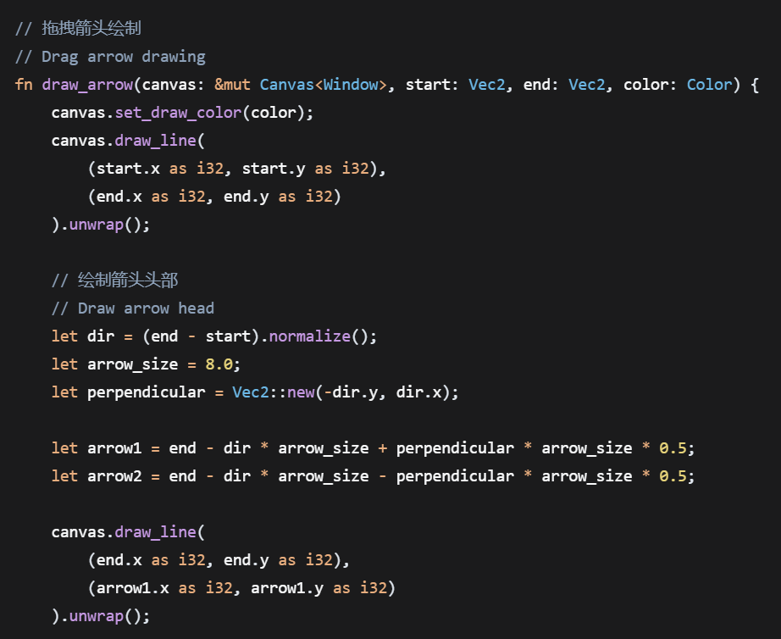
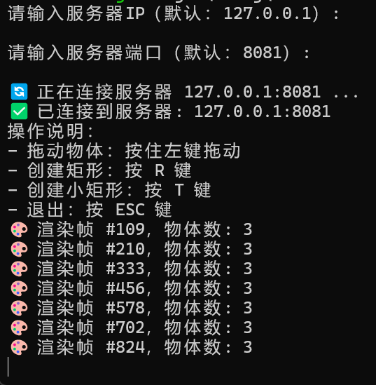
User Interface Design
Person 5: User Interaction Designer
FPS display
Performance indicator
Drag indicator
HePeng
Notes:
In terms of UI design, we added FPS display, performance monitoring indicators, and drag indicators. These help users understand the running state and clear operation feedback.

Slide 23
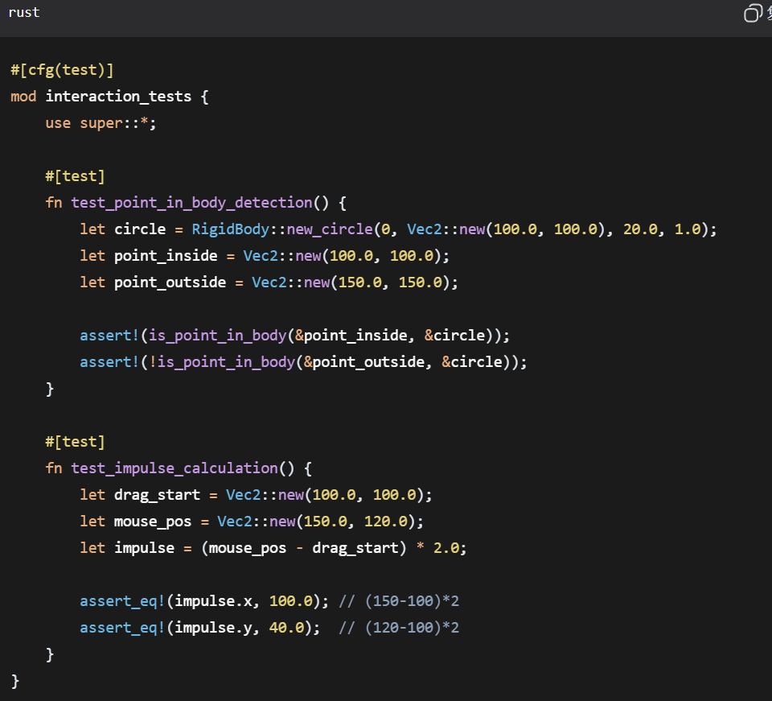
Interaction Optimization and Testing
Person 5: User Interaction Designer
Visual feedback
Operation smoothness
Error operation prevention
HePeng
Notes:
We also enhanced visual feedback to ensure smooth, delay-free operations. We added protection against wrong operations to avoid ruining the user experience. With these designs, users can easily get started and enjoy the fun of controlling the physics world. Next, let’s hand over to Huang Xiaofeng to show how to add exciting effects to these interactions.

Slide 24
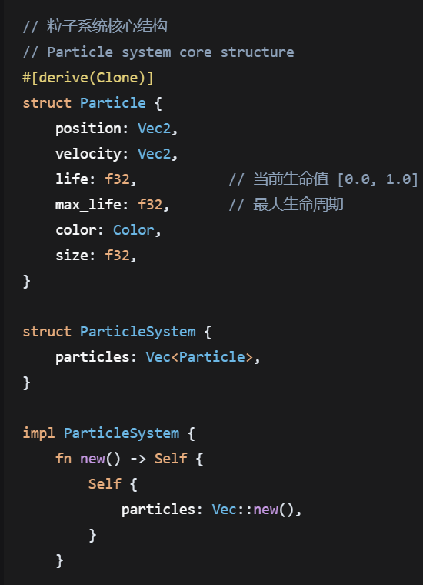
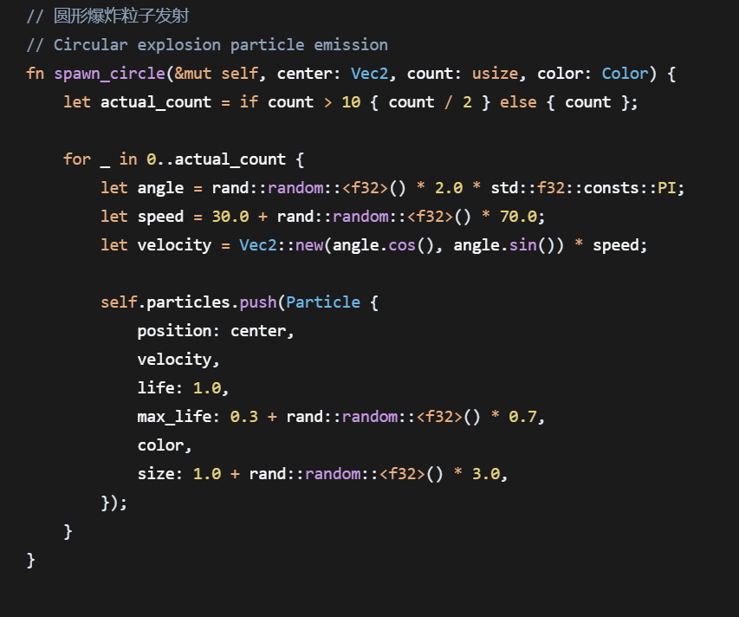
Particle System Architecture
Person 6: Special Effects System Engineer
Particle lifecycle management
Emitter design
Particle updating
HuangXiaoFeng
Notes:
Thanks to He Peng for the great interaction design! Hello everyone, I'm Huang Xiaofeng, in charge of developing the special effects system. Special effects are like the "finishing touch" of the project-they make physical interactions more visually striking.

Slide 25
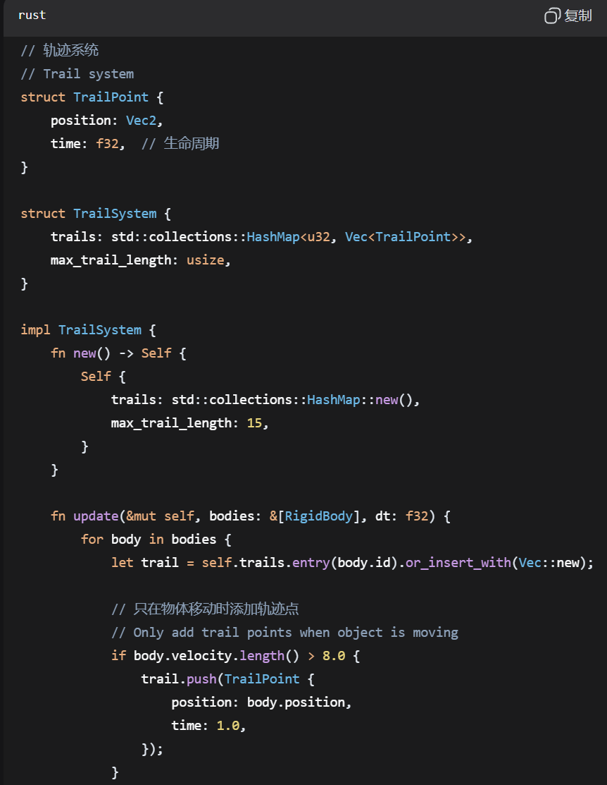
Trail System Design
Person 6: Special Effects System Engineer
Trail point management
Trail decay
Trail drawing
HuangXiaoFeng
Notes:
I designed a complete particle system architecture that manages particle lifecycles, emitters, and real-time updates. Each particle has its own position, speed, life value, and color. Emitters can generate particles at specified positions. The lifecycle management ensures particles are automatically created and destroyed, preventing excessive memory usage.

Slide 26
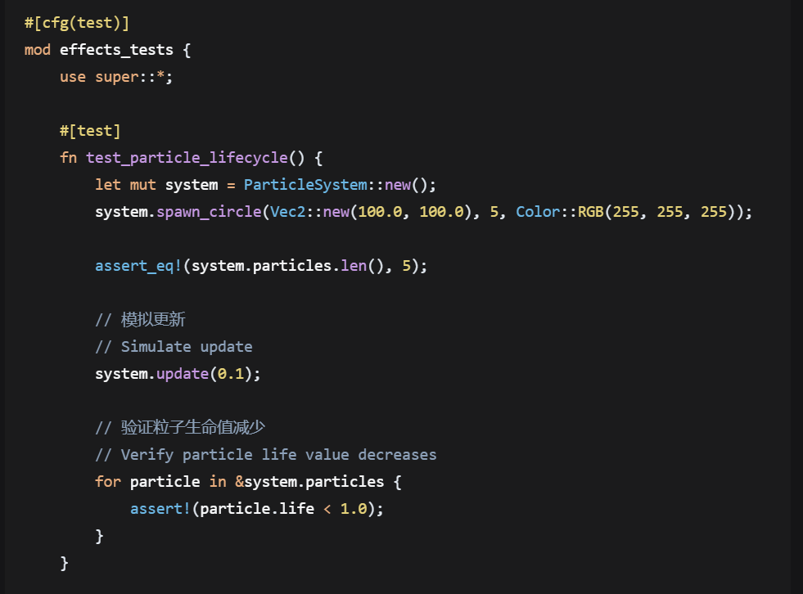
Performance Optimization and Testing
Person 6: Special Effects System Engineer
Particle count control
Automatic degradation
Memory management
HuangXiaoFeng
Notes:
For the trajectory system, we manage trajectory points and set decay rules to draw the traces of moving objects. We also support color gradients to enhance the effect. For collision effects, we detect new collision events and generate spark particles at the collision point. We adjust the number and color of particles based on collision intensity, making collisions more realistic.

Slide 27
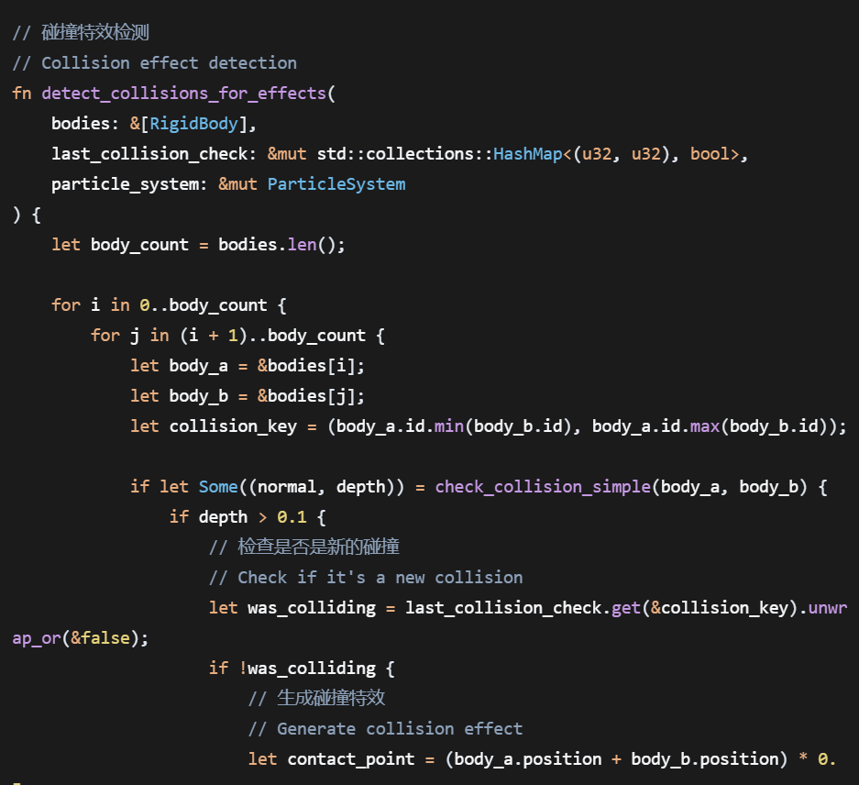
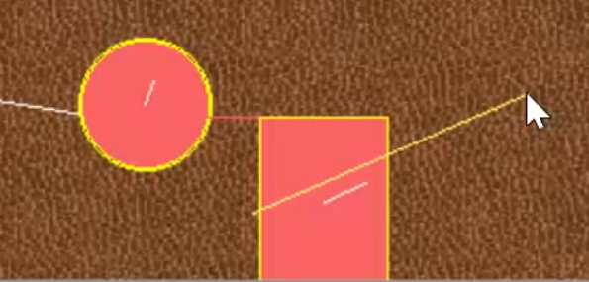
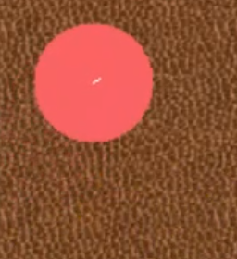
Collision Effects
Person 6: Special Effects System Engineer
Collision event detection
Spark particle generation
Effect color settings
HuangXiaoFeng
Notes:
For performance optimization, we set a maximum limit on the number of particles. We implemented an automatic degradation mechanism that reduces effect details when performance is low. We also managed memory well. These special effects greatly enhance the immersion of the physics sandbox. Next, let's hand over to Shen Yuhao to show how to integrate and deploy all these modules.

Slide 28
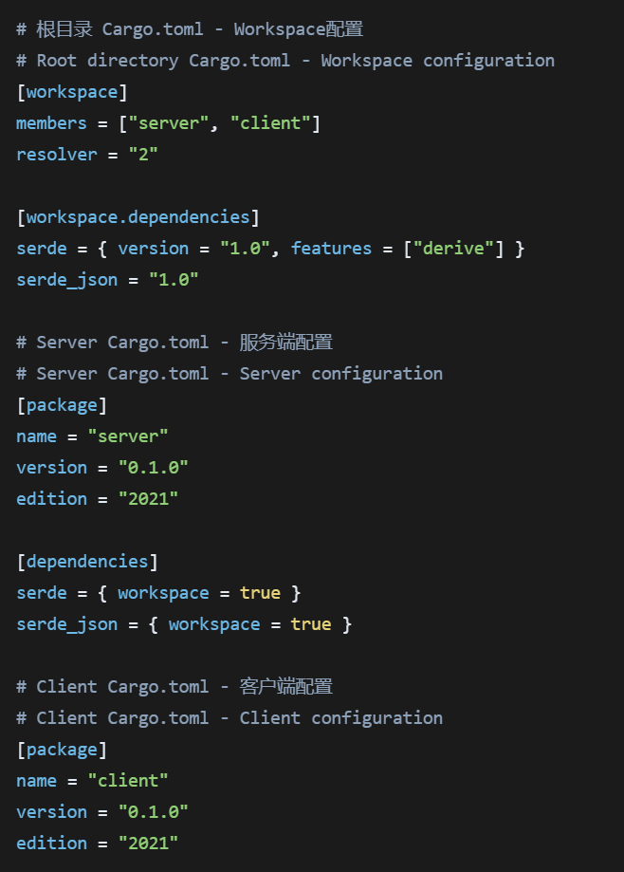
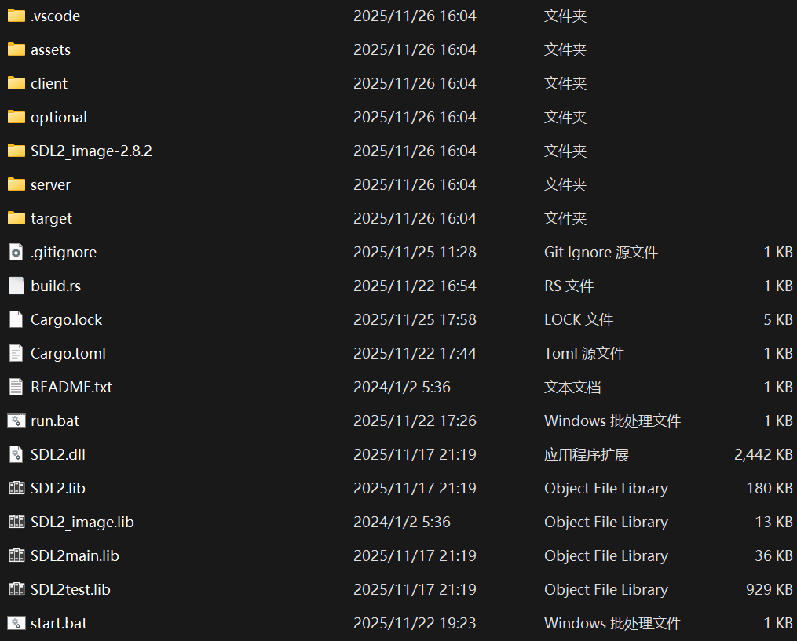
Project Structure Design
Person 7: Build and Deployment Engineer
Cargo Workspace organization
Member package management
Dependency sharing
ShenYuHao
Notes:
Speech 7: Shen Yuhao (Build and Deployment Module)
Thanks to Huang Xiaofeng for the wonderful special effects! Hello everyone, I’m Shen Yuhao, responsible for the project’s build and deployment. My job is to integrate all modules and ensure the project compiles, deploys, and runs smoothly.
In terms of project structure, we used a Cargo workspace to organize the code.

Slide 29
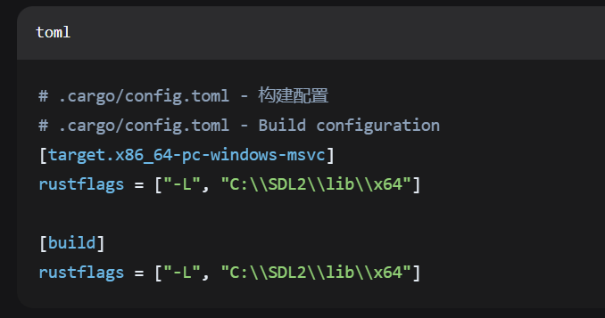
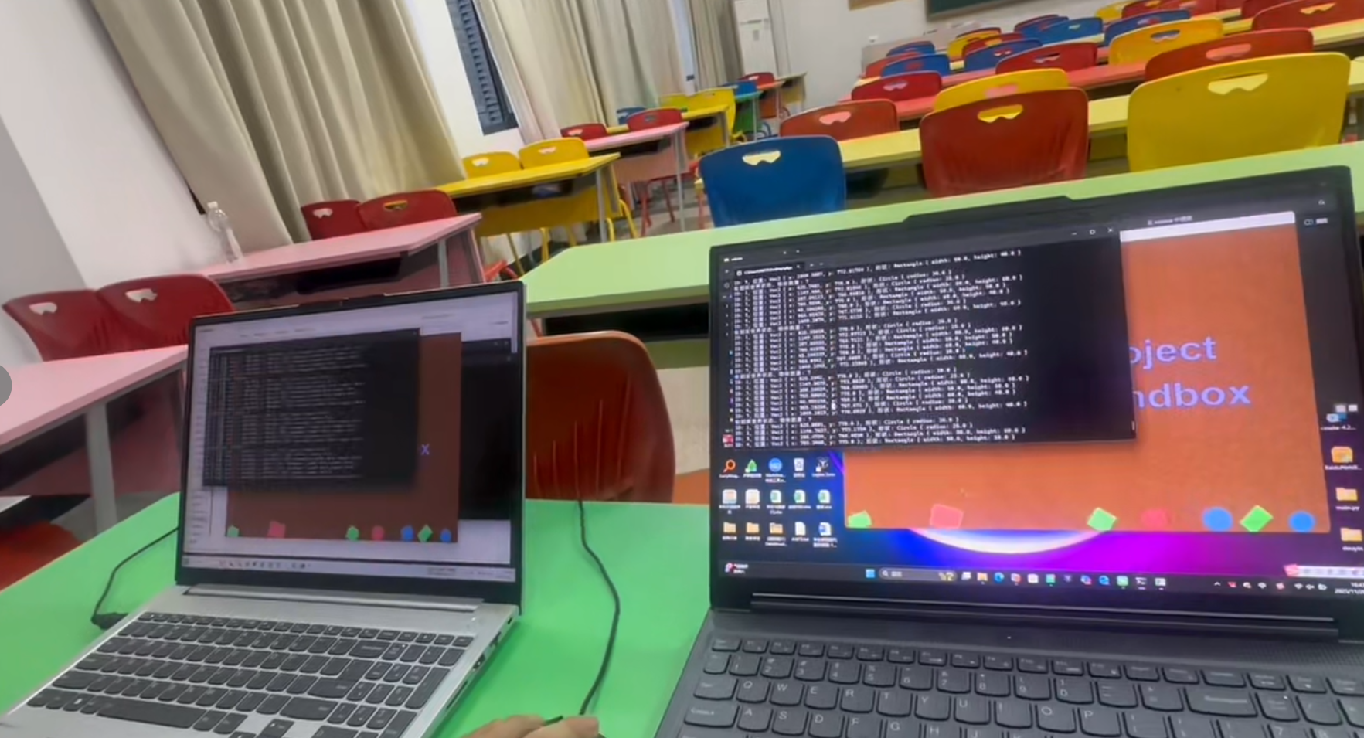
Dependency Management
Person 7: Build and Deployment Engineer
SDL2 library linking
Serialization library
Random number library
ShenYuHao
Notes:
This allows member package management and dependency sharing, so each module can be developed independently . We use the git to save our version code，So that we can redo all the version conveniently。For dependency management, we use the SDL2 library, the configuration of the Serde serialization library, and the introduction of the random number library.

Slide 30

Build Configuration
Person 7: Build and Deployment Engineer
Static library linking
Compilation flags
Target platform configuration
ShenYuHao
Notes:
verified that all key dependencies work through tests.
For build configuration, we set up static library linking, optimized compilation flags. This lets the project run on different systems. For deployment, we wrote automated deployment scripts to enable one-click deployment. We added environment detection to automatically

Slide 31

Deployment Script and Testing
Person 7: Build and Deployment Engineer
Automated deployment
Environment checking
Error handling
ShenYuHao
Notes:
adapt to the running environment. We also improved the error handling mechanism to provide timely feedback when problems occur.
Tests show the project can compile and build normally.So far, our networked 2D physics sandbox has formed a complete loop. Thank you to all team members for your hard work, and thank you everyone for listening!

Slide 32
Project Highlights: Beyond Requirements
Core Achievements
✅ Full 2D physics engine with server & multi-client sync
✅ Integrated networking, physics, and graphics
🚀 Key Breakthroughs
Physics Engine
Required: Particles
Delivered: Full rigid bodies with rotation & collision
Network Sync
Required: Basic broadcasting
Delivered: Predictive sync for seamless multi-user interaction
Engineering
Required: Basic demo
Delivered: Complete product with VFX, UI & auto-deployment
👥 Team Success
Modular design enabled parallel development
Solved core challenges in physics, sync & rendering
Delivered a showcase of our team's technical strength
A project that demonstrates our team's capability to exceed expectations.
• Core Responsibilities: Backend monitoring, status feedback, frontend-backend communication & synchronization maintenance
• Core Code Highlights: Management of key player workflow links (room signing, game tracking, new session creation)
All of our team
Notes:
A huge thanks to Professor Lin—your guidance on the physics engine and architecture was pivotal to our project’s success.
Today’s outcomes boil down to two key leaps:
First, a leap in tech & experience:
• Physics simulation: Beyond basic collisions, we added real-world logic (angular momentum, damping) + collision highlights for precision and intuitiveness.
• Network sync: We nailed "multi-client concurrency + lightweight communication" for smooth, stable collaboration.
• UX: SDL2 rendering + property visualization turned abstract physics into visible, easy-to-use interactions.
Second, a leap in teamwork:
From the physics team cracking collision formulas, to the network team fixing sync latency, to the frontend team polishing interactions—our modular workflow + shared docs turned individual efforts into a unified push. Small highlights from each role merged into a major project breakthrough.
This project isn’t just about exceeding requirements—it’s about our team growing from "working alone" to "supporting each other." Thanks again, Professor Lin, and I’m proud of this team

